Slide 1

Financial Accounting
John J. Wild
Seventh Edition
Copyright © 2015 McGraw-Hill Education. All rights reserved. No reproduction or distribution without the prior written consent of McGraw-Hill Education.

Slide 2
Chapter 1
Introducing Financial Accounting
Notes:
As with most texts, the first chapter will be devoted to an introduction to terms and techniques we will be using in the remaining chapters. For some, this may be your first business course and the terms will be new. We will be discussing many of the key concepts introduced here in the remaining chapters of the text.

Slide 3
Importance of Accounting
C1
is a
system that
Accounting
Identifies
Records
information
that is
Relevant
Communicates
Reliable
about an organization’s business activities.
Comparable
1-<number>
Notes:
Accounting is an information and measurement system that identifies, records, and communicates information that is relevant, reliable, and comparable about an organization’s business activities. The goal of the accounting process is to provide helpful information to users of financial information. Quality information may help users reach more informed decisions.

Slide 4





Accounting Activities
C 1
Identifying Business Activities
Recording Business Activities
Communicating Business Activities
1-<number>
Notes:
Not all transactions entered into by a business entity are capable of being recorded. Our first task as accountants is to identify those transactions that may be recorded in the accounting system.
To record business transactions, we must follow the rules of double-entry bookkeeping. We will spend a significant amount of time early in the course discussing in detail the rules of the accounting process.
Communicating business activities requires preparing accounting reports such as financial statements. It also requires analyzing and interpreting such reports.

Slide 5





Users of Accounting Information
C 2
External Users
Internal Users
Lenders
Shareholders
Governments
Consumer groups
External auditors
Customers
Managers
Officers
Internal auditors
Sales staff
Budget officers
Controllers
1-<number>
Notes:
We must follow standard formatting when reporting information to users outside the organization. External users include stockholders of the company, lenders, various governmental agencies, and others.
Accountants also prepare reports for internal users. Managers of the business need information to help direct and control operations of a business. The sales/marketing department needs information about customers and products. Officers of the company need information to develop strategic plans.

Slide 6
Users of Accounting Information
C 2
External Users
Internal Users
Financial accounting provides external users (shareholders, lenders, etc.) with financial statements.
Managerial accounting provides information needs for internal decision makers (officers, managers, etc.).
1-<number>
Notes:
Financial accounting provides external users with financial statements. Managerial accounting provides information needs for internal decision makers.
In this book, we will spend most of our time developing financial accounting information for external users. Some of the material we cover will prove useful to managers and other internal decision makers.

Slide 7
Opportunities in Accounting
C 2
Managerial
Taxation
Financial
General accounting
Cost accounting
Budgeting
Internal auditing
Consulting
Controller
Treasurer
Strategy
Preparation
Planning
Regulatory
Investigations
Consulting
Enforcement
Legal services
Estate plans
Preparation
Analysis
Auditing
Regulatory
Consulting
Planning
Criminal
investigation
Lenders
Consultants
Analysts
Traders
Directors
Underwriters
Planners
Appraisers
FBI investigators
Market researchers
Systems designers
Merger services
Business valuation
Forensic accountant
Litigation support
Entrepreneurs
Accounting-related
1-<number>
Notes:
Careers in accounting can follow many paths.
There is great demand for financial accountants in the preparation of financial statements, dealing with regulatory agencies like the Internal Revenue Service, and consulting.
Management accountants help track product costs, prepare budgets, and serve as a consultant to managers.
The field of taxation includes everything from the preparation of tax returns to consulting with clients about estate and gift planning.
Individuals with accounting backgrounds may move into other areas of importance within an organization. Individuals with accounting training often become business owners and managers. They are in high demand in all financial and investigative fields.

Slide 8
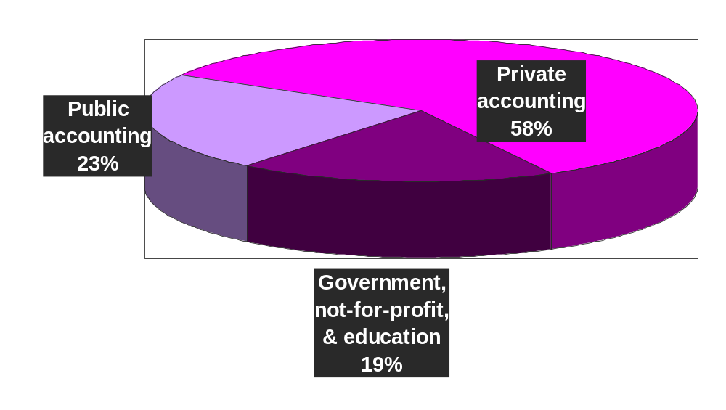
Accounting Jobs by Area
C2
1-<number>
Notes:
About 23% of accountants work in public accounting. Public accounting firms offer accounting, tax, and consulting services to a wide variety of clients. About 58% of accountants work for businesses and corporations, and 19% work for governmental, not-for-profit, and educational organizations.

Slide 9
Ethics—A Key Concept
C 3
Ethics
Beliefs that distinguish right from wrong
Accepted standards of good and bad behavior
1-<number>
Notes:
Ethical behavior is the cornerstone of the accounting profession. Recently, we have seen many corporate scandals involving individuals who acted in an unethical, and often illegal, way.
Ethics is the belief system that permits us to distinguish right from wrong. It is something we develop over our lifetimes that serves to help us identify good and bad behavior. Congress passed the Sarbanes-Oxley Act, also known as SOX, to help curb financial abuses at companies that issue their stock to the public. The desired results include more transparency, accountability, and truthfulness in reporting transactions.

Slide 10



Guidelines for Ethical Decisions
C3
Identify ethical concerns
Analyze options
Make ethical decision
Use personal ethics to recognize an ethical concern.
Consider all good and bad consequences.
Choose best option after weighing all consequences.
1-<number>
Notes:
You have faced ethical situations in school and will face similar situations at work. We should be capable of identifying ethical concerns and analyzing our options, that is, what is the right and wrong thing to do. Making an ethical decision means choosing the best option available under the circumstances.

Slide 11
Generally Accepted Accounting Principles
C 4
Financial accounting is governed by concepts and rules known as generally accepted accounting principles (GAAP).
Relevant Information
Affects decisions of its users.
Reliable Information
Is trusted by users.
Comparable Information
Used in comparisons across years & companies.
1-<number>
Notes:
Financial accounting in governed by a set of rules we call generally accepted accounting principles, or GAAP for short.
Generally accepted accounting principles identify three major characteristics of information. First, the information must be relevant. Relevant information impacts the decision of the informed user for financial information. Second, the information must be reliable. Finally, the information must be comparable. Comparability helps us compare financial information from one period with that of the next period.

Slide 12
Setting Accounting Principles
C4
In the United States, the Securities and Exchange Commission, a government agency, has the legal authority to establish reporting requirements and set GAAP for companies that issue stock to the public.
The Financial Accounting Standards Board is the private group that sets both broad and specific principles.
The International Accounting Standards Board (IASB) issues inter-
national standards that identify preferred accounting practices
in other countries. More than 115 countries now require or permit
companies to prepare financial reports following IFRS.
1-<number>
Notes:
In the public sector, the Securities and Exchange Commission has the authority to establish accounting principles for companies reporting to the agency.
The Financial Accounting Standards Board is recognized as the group in the private sector that makes specific accounting principles. If an accountant departs from the principles established by the FASB, proper disclosure of the departure must be made.
The IASB, or International Accounting Standards Board, issues international standards that identify preferred accounting practices. More than 115 countries now require or permit companies to prepare financial reports following IFRS.

Slide 13
Principles and Assumptions of Accounting
C 4
Measurement principle (also called cost principle) means that accounting information is based on actual cost.
Going-concern assumption means that accounting information reflects a presumption the business will continue operating.
Revenue recognition principle provides guidance on when a company must recognize revenue.
Monetary unit assumption means we can express transactions in money.
Matching principle (expense recognition) prescribes that a company must record its expenses incurred to generate the revenue.
Time period assumption presumes that the life of a company can be divided into time periods, such as months and years.
Full disclosure principle requires a company to report the details behind financial statements that would impact users’ decisions.
Business entity assumption means that a business is accounted for separately from its owner or other business entities.
1-<number>
Notes:
Here are some key principles and assumptions of accounting.
Accounting Principles
The measurement principle (also called the cost principle) tells us that accounting information is based upon actual costs incurred. We refer to this cost as historical cost.
The revenue recognition principle provides guidance on when a company must recognize revenue.
The matching principle (expense recognition) prescribes that a company must record its expenses incurred to generate the revenues reported.
The principle of full disclosure requires a company to report the details behind financial statements that would impact users’ decisions.
Accounting Assumptions
The going-concern assumption states that, in the absence of information to the contrary, the business entity is assumed to continue operations into the foreseeable future.
The monetary unit assumption means transactions can be expressed in monetary terms.
The time period assumption presumes that the life of a company can be divided into time periods, such as months and years.
A business entity means that a business is accounted for separately from its owner or other business entities.

Slide 14



Business Entity Forms
C 4
Sole Proprietorship
Partnership
Corporation
1-<number>
Notes:
There are three general forms of business operations. A sole proprietorship is a business owned by just one individual. A partnership is owned by two or more individuals. Some partnerships have several thousand partners. A corporation is owned by individuals who normally are not active in the day-to-day operations of that business. For example, you may become an owner of IBM by purchasing shares of stock on the New York Stock Exchange. While you are a part owner, you do not necessarily work for IBM nor are you active in the operations of the company.

Slide 15
Sarbanes-Oxley Act
C 4
In response to a number of publicized accounting scandals (Enron, WorldCom, Tyco, ImClone), Congress passed the Sarbanes-Oxley Act (also called SOX) in 2002 to help curb financial abuses at companies that issue their stock to the public. The act requires that public companies apply both accounting oversight and stringent internal controls. The desired results include more transparency, accountability, and truthfulness in reporting transactions.
1-<number>
Notes:
In response to a number of publicized accounting scandals (Enron, WorldCom, Tyco, ImClone), Congress passed the Sarbanes-Oxley Act (also called SOX) in 2002 to help curb financial abuses at companies that issue their stock to the public. The act requires that public companies apply both accounting oversight and stringent internal controls. The desired results include more transparency, accountability, and truthfulness in reporting transactions.

Slide 16


Accounting Equation
A1
=
+
Assets
Liabilities
Equity
Liabilities + Equity
Assets
1-<number>
Notes:
The basic accounting equation states that assets are equal to liabilities plus equity of a company. The equation makes sense because in a general way it states that assets must be equal to the claims against those assets. If we have an asset, we can have two broad categories of claims against that asset. First, we may have claims by creditors for liabilities and then, after all creditor claims are satisfied, the residual owners and stockholders have a claim on those assets.

Slide 17
Assets
A1
Cash
Accounts Receivable
Notes Receivable
Resources owned or controlled by a company
Vehicles
Land
Buildings
Store Supplies
Equipment
1-<number>
Notes:
Assets may be viewed as resources owned or controlled by a company. They include such items as cash, accounts receivable (amounts owed to the company by customers), land, building and equipment, and supplies.

Slide 18
Liabilities
A1
Accounts Payable
Notes Payable
Creditors’ claims on assets
Taxes Payable
Wages Payable
1-<number>
Notes:
Liabilities represent the claims of creditors on the entity’s assets. Liabilities include accounts payable (amounts we owe to creditors for assets purchased on account), notes payable, taxes payable, and wages payable (amounts we owe to our employees at the end of the accounting period).

Slide 19
Equity
A1
Contributed Capital
Retained Earnings
Owner’s
claim on
assets
Dividends
1-<number>
Notes:
The equities of an entity include investments by owners, contributed capital, and payments to those owners (dividends). Retained earnings represents all of the accumulated earnings of a corporation that have not been distributed to shareholders.

Slide 20
Expanded Accounting Equation
A1
=
+
Assets
=
Liabilities
+
Equity
Assets
Liabilities
Equity
_
_
Contributed Capital
Dividends
+
Revenues
Expenses
Retained Earnings
1-<number>
Notes:
Here is a breakdown of the equity section of the accounting equation to show the mathematical signs we will be using to keep track of investments by owners, common stock, payments to owners (dividends), revenues, and expenses. Notice that revenues increase equity and expenses reduce equity.

Slide 21
Transaction Analysis
P1
Business activities can be described in terms of transactions and events. External transactions are exchanges of value between two entities, which yield changes in the accounting equation. Internal transactions are exchanges within any entity; they can also affect the accounting equation. Events refer to happenings that affect an entity’s accounting equation and can be reliably measured. Transaction analysis is defined as the process used to analyze transactions and events.
1-<number>
Notes:
Business activities can be described in terms of transactions and events. External transactions are exchanges of value between two entities, which yield changes in the accounting equation. Internal transactions are exchanges within any entity; they can also affect the accounting equation. Events refer to happenings that affect an entity’s accounting equation and can be reliably measured. Transaction analysis is defined as the process used to analyze transactions and events.

Slide 22
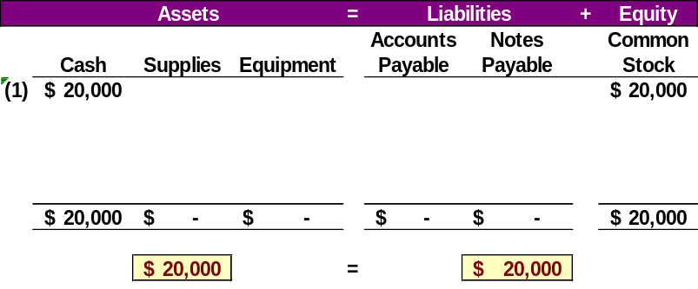
Transaction Analysis
P1
S. Scott invests $20,000 cash to start the business in return for stock.
1-<number>
Notes:
Here we show the increase in the asset account Cash and the increase in the equity account Common Stock by $20,000. Our basic accounting equation is in balance. Assets have a total balance of $20,000 and liabilities plus equity have a total balance of $20,000 . Let’s move on to another transaction.

Slide 23
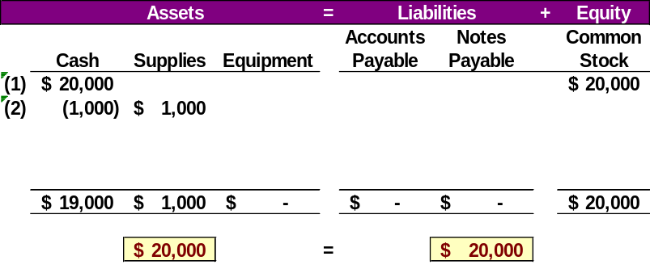
Transaction Analysis
P1
Purchased supplies with $1,000 cash.
1-<number>
Notes:
We can see the decrease in cash and the increase in supplies. The total assets are still equal to $20,000 but are divided between cash and supplies. There is no change on the liabilities plus equity section of our books.

Slide 24
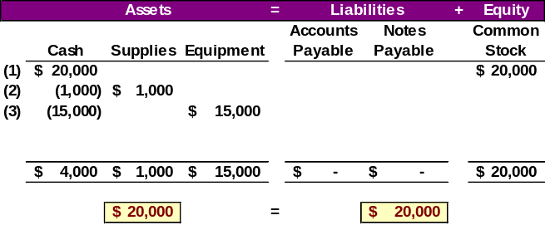
Transaction Analysis
P1
Purchased equipment for $15,000 cash.
1-<number>
Notes:
Cash is reduced by $15,000 and Equipment is increased by $15,000. The balance in our Cash account is now $4,000. We have a current balance in Supplies of $1,000, and Equipment of $15,000. The three asset accounts total $20,000. Once again, there has been no change in the liabilities plus equity side of the equation.

Slide 25
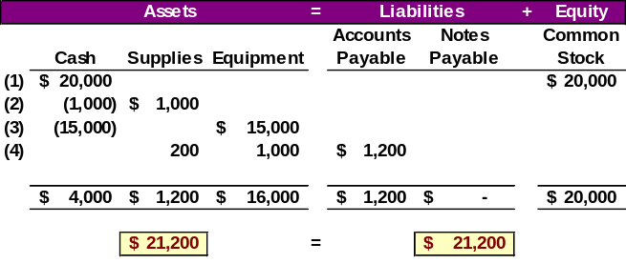
Transaction Analysis
P1
Purchased supplies of $200 and equipment of $1,000 on account.
1-<number>
Notes:
You can see the balance in the Cash, Supplies, and Equipment accounts. The total on the asset side of the equation is $21,200. We acquired the assets without paying cash. If you use a credit card to purchase gas for your car, you receive an asset, gas, and incur an account payable to the credit card company. The balance in the liabilities accounts is now $1,200, and the Common Stock account balance is still $20,000.

Slide 26
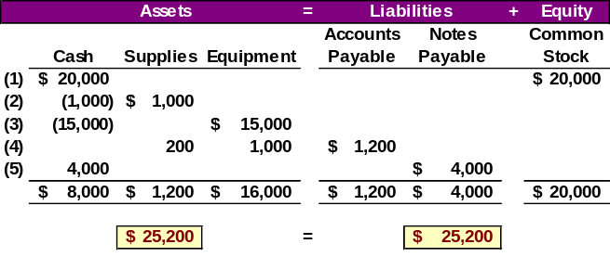
Transaction Analysis
P1
Borrowed $4,000 from 1st American Bank.
1-<number>
Notes:
The asset account Cash increased by $4,000 and the liability account Notes Payable increased by $4,000. The asset side of the equation now has a balance of $25,200. The liabilities plus equity side of the equation has the same total balance, so our books are in balance.

Slide 27
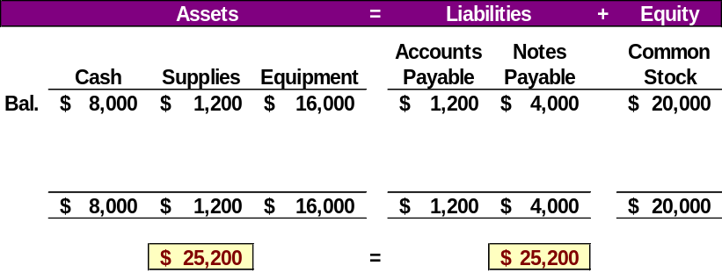
Transaction Analysis
P1
The balances so far appear below. Note that the accounting equation is still in balance.
1-<number>
Notes:
Notice that the sum of all assets is equal to the sum of liabilities and equity. The accounting equation is in balance as required.

Slide 28
Transaction Analysis
P1
Now, let’s look at transactions involving revenues, expenses, and dividends.
1-<number>
Notes:
To this point, we have not looked at transactions involving revenues, expenses, and dividends. In the next few slides we will address these accounts.

Slide 29
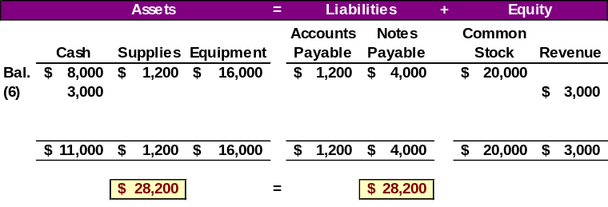
Transaction Analysis
P1
Provided $3,000 of consulting services and received payment immediately.
1-<number>
Notes:
You see that our Cash account increases by $3,000, to a current balance of $11,000. Total assets amount to $28,200. The revenue account also increased by $3,000. Recall that from our expanded accounting equation that revenues increase equity and expenses decrease equity. The total of our liabilities plus equity is now $28,200.

Slide 30
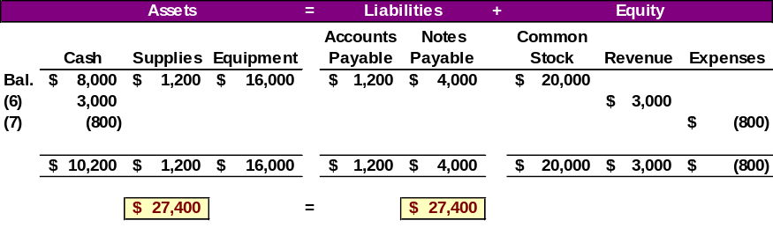
Transaction Analysis
P1
Paid salaries of $800 to employees.
Remember that expenses decrease equity.
1-<number>
Notes:
Let’s think about what happens when the firm pays their employees $800 for work performed. What will be the effect on the accounting equation?
How did you do? You got the decrease in the Cash account, but did you remember to show the increase in expenses as a decrease in total equity? Our expanded equation is getting to look more and more complicated. Don’t worry, practice will help you fully understand the recording of these and similar transactions. Our books are still in balance.

Slide 31
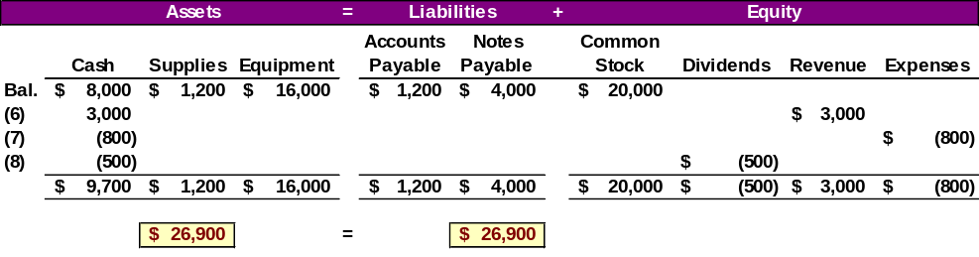
Transaction Analysis
P1
Dividends of $500 are paid to shareholders.
Remember that dividends decrease equity.
1-<number>
Notes:
Did you get this transaction recorded properly? We hope so. The asset account, Cash, decreased by $500 and the equity account, Dividends increased by $500. The Dividends account reduces the total equity of the company in the same way that expenses decrease equity. The final balances show that total assets are equal to $26,900. The total of the liabilities plus the equity has the same balance. Let’s use the information we developed to this point to prepare our basic accounting reports.

Slide 32

Financial Statements
P2
Let’s prepare the Financial Statements reflecting the transactions we have recorded.
Income Statement
Statement of Retained Earnings
Balance Sheet
Statement of Cash Flows
1-<number>
Notes:
There are four fundamental financial statements used in accounting.
The income statement shows revenues and expenses.
The statement of retained earnings shows the change in the retained earnings account during the current period.
The balance sheet is a listing of all asset, liability, and equity account balances.
The statement of cash flows shows where the company obtained its cash and how it spent its cash.
The first financial statement that we will prepare is the income statement. Let’s get started.

Slide 33
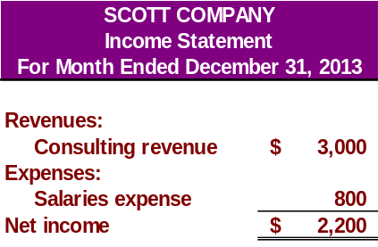
Income Statement
P2
Net income is the difference between Revenues and Expenses.
The income statement describes a company’s revenues and expenses along with the resulting net income or loss over a period of time due to earnings activities.
1-<number>
Notes:
Net income is defined as the difference between revenues and expenses. If expenses exceed revenues, we have a net loss rather than net income. Financial statements have a three line title with the company name, the name of the statement, and the period covered by the report. In our case, we had total revenues of $3,000 and total expenses of $800, so net income for the month ended December 31, 2013, was $2,200. After completing the income statement, we may prepare the statement of retained earnings.

Slide 34
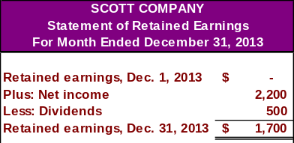
Statement of Retained Earnings
P2
The net income of $2,200 increases Retained Earnings by $2,200.
1-<number>
Notes:
In the statement of retained earnings, we start with the balance at the beginning of the period, add net income earned during the period, and deduct any dividends paid, resulting in the ending balance in retained earnings. The company was started this month, so the beginning balance in retained earnings was zero. During December, net income of $2,200 was earned. In addition, $500 in dividends was paid, so the ending balance in retained earnings is $1,700. After we complete this statement, we can prepare the balance sheet.

Slide 35
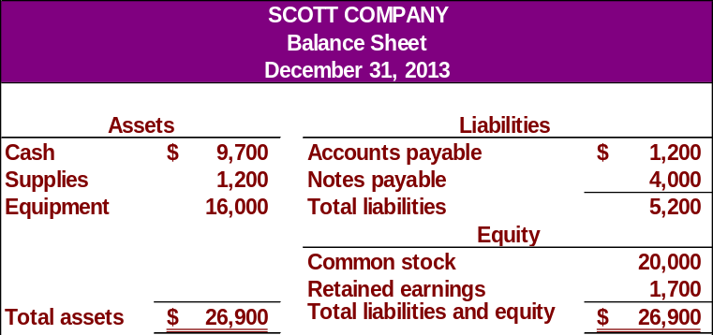
Balance Sheet
P2
The Balance Sheet describes a company’s financial position at a point in time.
1-<number>
Notes:
The balance sheet is an inventory of assets, liabilities and equity at the end of the month. Our total assets are equal to $26,900. This includes cash of $9,700, supplies of $1,200, and equipment of $16,000.
Liabilities include accounts payable of $1,200 and notes payable of $4,000. The common stock account has a balance of $20,000 and we just calculated the ending balance in retained earnings of $1,700. You can see that the books are in balance because total assets are equal to total liabilities plus equity.
Creditors have claims against our assets of $5,200. The owner has claims to assets of $21,700.

Slide 36
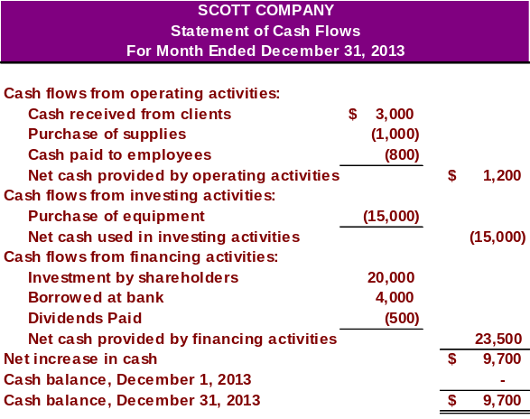
Statement of Cash Flows
P2
1-<number>
Notes:
We will cover the statement of cash flows in detail in a later chapter. Notice that the statement is divided into three major sections; (1) cash flows from operating activities; (2) cash flows from investing activities; and (3) cash flows from financing activities. The statement reconciles to the ending cash balance on the balance sheet of $9,700.

Slide 37

Return on Assets (ROA)
A2
Return on
assets
Net income
Average total assets
=
ROA is a profitability measure.
1-<number>
Notes:
Return on assets is a profitability measure. It helps us measure the operating efficiency of a company. Return on assets is calculated by dividing net income by average total assets. In most cases the simple average is used. Add the beginning and ending balance of total assets and divide by two to get a simple average.

Slide 38

End of Chapter 1
1-<number>
Notes:
This completes our discussion of Chapter 1. We have introduced many new concepts and procedures. Your homework assignments will help reinforce most of what we have covered in our presentation. If you have difficulty with your homework assignments, you may want to review this presentation again. Good luck.

